Slide 1
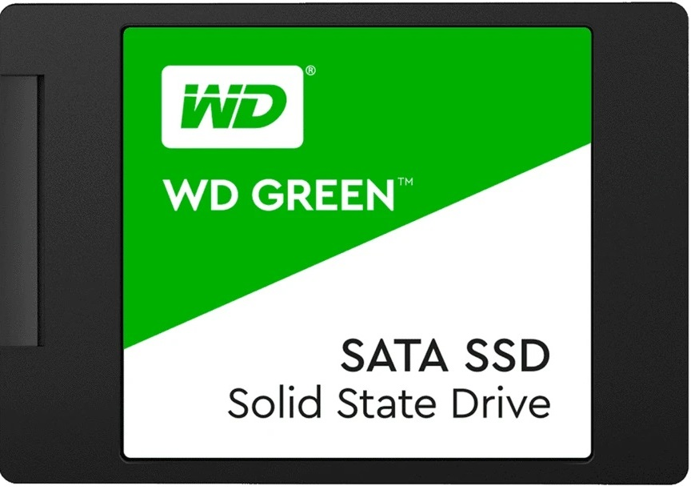
SoLID STATE DRIVE (SSD) Presentation #01
Student Name : ABDUL RAFEH
Student ID : CSC-20S-104
Section : CS I - C
Course : CSC101 - ICT
Course Instructor : DR. ASIF ALI LAGHARI

Slide 2
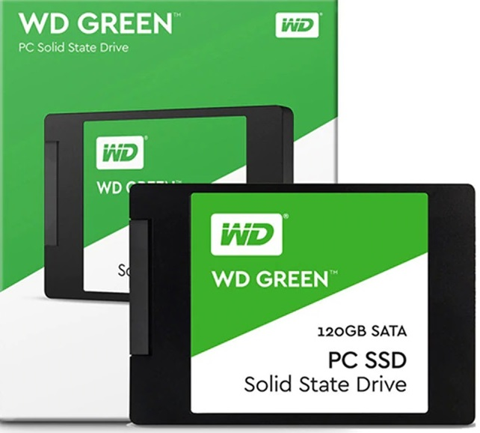
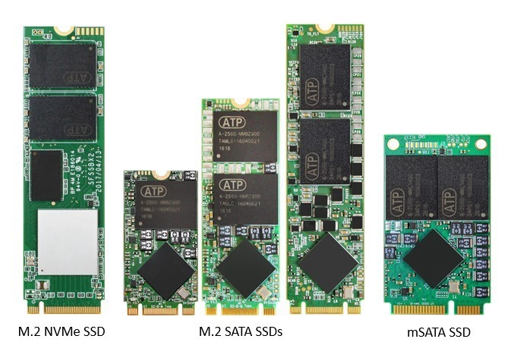
CONTENTS
What is SSD?
Introduction of SSD
Different Types of SSD
Advantages
Disadvantages
SSD Application
Difference Between HDD & SSD
Technical Comparison of HDD & SSD

Slide 3
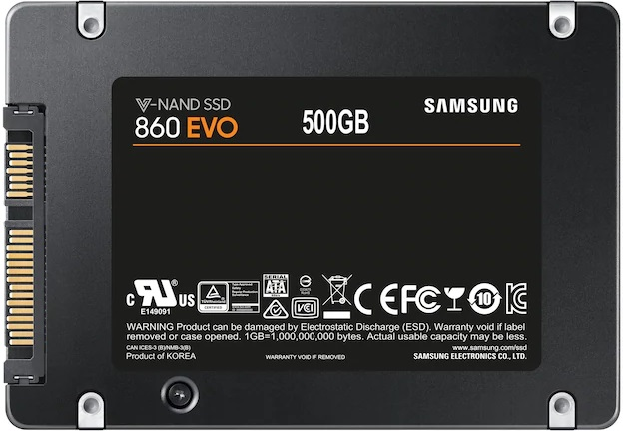
What is ssd?
SSD stands for solid-state drive.
SSD a type of PC storage that's faster than a
hard disk drive (HDD).
SSD is able to read and write data much
faster than a mechanical hard disk drive (HDD).
SSD is at least three times as fast as a hard disk drive (HDD).
You’ll especially notice the difference when
turning your PC on, opening an application,
or switching between tasks.

Slide 4

Introduction of SSD?
In 1995, M-System introduced first flash-based solid state drives (SSD).
SSDs do not have moving mechanical components, which distinguishes them from traditional magnetic disks such as hard disk drives (HDDs).
The new solid-state drives work completely differently. They use a simple memory chip called NAND flash memory, which has no moving parts and near-instant access times.

Slide 5
Different types of ssd
When you shop for an SSD, you’ll encounter a number of different terms such as SATA or PCIe. So what does it all mean? Here’s a primer on what you need to know.
SATA SSDs:
SATA SSDs look like laptop hard drives, flat and rectangular like the Shown in picture. They are the lowest grade SSD and use the same interface as hard drives. However, a PC that uses a SATA SSD has three to four times the bandwidth (how much data it can read/write simultaneously) than a PC using a hard drive. SATA SSDs are also more abundant and cheaper than NVMe-PCIe ones and are still great for common applications.

Slide 6
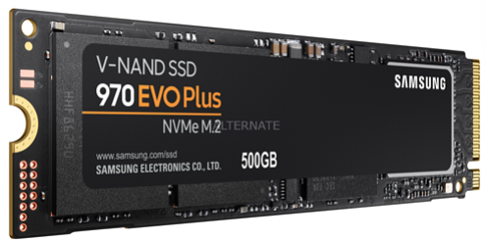
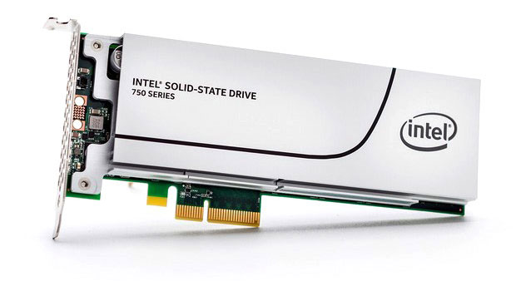
PCIe and NVMe SSDs:
PCI Express (PCIe) is normally used to connect graphics cards, network cards, or other high-performance peripherals.
One type of SSD is PCIe/NVMe/PCIe NVMe SSDs. PCIe stands for peripheral component interconnect express, and NVMe stands for non-volatile memory express. A PC using the fastest PCIe-NVMe SSD reads and writes at four or five times the speed of a PC using a SATA SSD. As such, PCIe-NVMe SSDs are better and more expensive than SATA SSDs. To install a PCIe-NVMe SSD onto your motherboard, you'll need to buy a motherboard with PCIe slots.

Slide 7
ADVANTAGES
DISADVANTAGES
Vibration Resistance: With the absence of moving parts SSDs have more vibration resistance than the other hard drives. Vibration resistance of SSDs is 20x more than hard drives.
Improved Response Time: With SSDs response time is improved by 75% whereas there is a significant decrease in the daily backup time. If a normal hard drive takes 6 hours for daily back up than in case of SSDs it will take less than 2 hour. This quick response time and decreased backup time leads to customer satisfaction.
Faster File Transfer: File transfer becomes really faster with SSDs. Their less access time and response time make file transfer faster. So you don’t have to wait long to transfer larger GB file.
Master Multitasking: SSD can smoothly handle multiple programs so with SSDs you can perform different work in less time and with more efficiency.
Cost: Besides all the advantages and useful application what makes customer really think before buying SSDs is the Cost of SSDs.
Data Recovery: SSD uses much more nonlinear and complex way of storing data as compared to hard disks therefore it becomes complex to recover data.
Need secondary memory in support to SSD: We cannot use SSDs alone. It is always used with secondary memory which is hard drives.
Calculation of space: File systems have superblocks and inodes whose size is not easy to calculate. Allocating a random space for these file systems would be much costlier in case of SSD.

Slide 8
Ssd application
Desktop Computers
Laptops
Ultra Books
Servers
Smart TV
HD Camcorder
CCTV Digital Video Recorder (DVR)
Mobile Phones
Set Top Boxes
Gaming Consoles

Slide 9
Difference between hdd & ssd
HDD
SSD
Hard Disk Drive
HDD has higher latency, longer read/write times, and supports fewer IOPs (input output operations per second) compared to SSD.
Hard disk drives use more electricity to rotate the platters, generating heat and noise.
The performance of HDD drives worsens due to fragmentation; therefore, they need to be periodically defragmented.
HDDs are heavier than SSD drives.
Solid State Drive
SSD has lower latency, faster read/writes, and supports more IOPs (input output operations per second) compared to HDD.
Since no such rotation is needed in solid state drives, they use less power and do not generate heat or noise.
SSD drive performance is not impacted by fragmentation. So defragmentation is not necessary.
SSD drives are lighter than HDD drives because they do not have the rotating disks, spindle and motor.

Slide 10
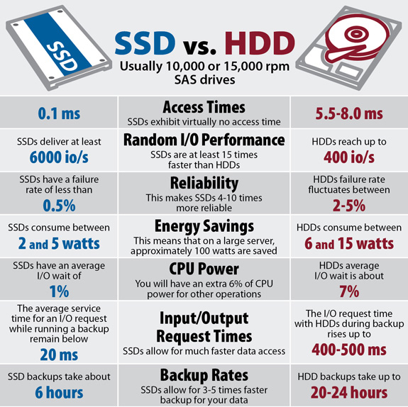
Technical Comparison of HDD & SSD

Slide 11


Slide 12


